Slide 1

CSE2PM09A / AID2PM07A
Design and Analysis of Algorithm
DEPARTMENT OF COMPUTER ENGINEERING AND TECHNOLOGY

Slide 2
Symbol Table

Slide 3

Symbol Table
Introduction to Symbol Tables
Static tree table- Optimal Binary Search Tree (OBST)
Dynamic tree table-AVL tree
Multiway search tree- B-Tree

Slide 4
Symbol Table
Symbol table is defined as a name-value pair
Symbol tables are data structures that are used by compilers to hold information about source-program constructs.

Slide 5
Symbol Tables
Associates attributes with identifiers used in a program
For instance, a type attribute is usually associated with each identifier
A symbol table is a necessary component
Definition (declaration) of identifiers appears once in a program
Use of identifiers may appear in many places of the program text
Identifiers and attributes are entered by the analysis phases
When processing a definition (declaration) of an identifier
In simple languages with only global variables and implicit declarations: The scanner can enter an identifier into a symbol table if it is not already there
In block-structured languages with scopes and explicit declarations: The parser and/or semantic analyzer enter identifiers and corresponding attributes

Slide 6
Symbol Tables
Symbol table information is used by the analysis and synthesis phases
To verify that used identifiers have been defined (declared)
To verify that expressions and assignments are semantically correct – type checking
To generate intermediate or target code

Slide 7
The Symbol Table
When identifiers are found, they will be entered into a symbol table, which will hold all relevant information about identifiers.
This information will be used later by the semantic analyzer and the code generator.
Lexical
Analyzer
Syntax
Analyzer
Semantic
Analyzer
Code
Generator
Symbol
Table

Slide 8
SYMBOL TABLE - NAMES
Variable and labels
Parameter
Constant
NAME
Record
RecordField
Procedure
Array and files

Slide 9
SYMBOL TABLE-ATTRIBUTES
Each piece of information associated with a name is called an attribute.
Attributes are language dependent.
Different classes of Symbols have different Attributes
Variable, Constants
Procedure or function
Array
Type, Line number where declared, Lines where referenced, Scope
Number of parameters, parameters themselves, result type.
# of Dimensions, Array bounds.

Slide 10
Symbol Table
While compilers and assemblers are scanning a program, each identifier must be examined to determine if it is a keyword
This information concerning the keywords in a programming language is stored in a symbol table
Symbol table is a kind of ‘keyed table’
The keyed table stores <key, information> pairs with no additional logical structure

Slide 11
Symbol Table (Continued)
The operations performed on symbol tables are the following:
Insert the pairs <key, information> into the collection
Remove the pairs <key, information> by specifying the key
Search for a particular key
Retrieve the information associated with a key

Slide 12
Possible implementations
Unordered list: for a very small set of variables.
Simplest to implement
Implemented as an array or a linked list
Linked list can grow dynamically – alleviates problem of a fixed size array
Insertion is fast O(1), but lookup is slow for large tables – O(n) on average.
Ordered linear list:
If an array is sorted, it can be searched using binary search – O(log₂n)
Insertion into a sorted array is expensive – O(n) on average
Useful when set of names is known in advance – table of reserved words

Slide 13
Possible implementations
Binary search tree:
Can grow dynamically
Insertion and lookup are O(log₂n) on average

Slide 14
Representation of Symbol Table
There are two different techniques for implementing a keyed table:
Static Tree Tables
Dynamic Tree Tables

Slide 15
Static Tree Tables
When symbols are known in advance and no insertion and deletion is allowed, it is called a static tree table
An example of this type of table is a reserved word table in a compiler

Slide 16
Dynamic Tree Table
A dynamic tree table is used when symbols are not known in advance but are inserted as they come and deleted if not required
Dynamic keyed tables are those that are built on-the-fly
The keys have no history associated with their use

Slide 17
Optimal Binary Search Trees
To optimize a table knowing what keys are in the table and what the probable distribution is of those that are not in the table, we build an optimal binary search tree (OBST)
Optimal binary search tree is a binary search tree having an average search time of all keys optimal
An OBST is a BST with the minimum cost

Slide 18
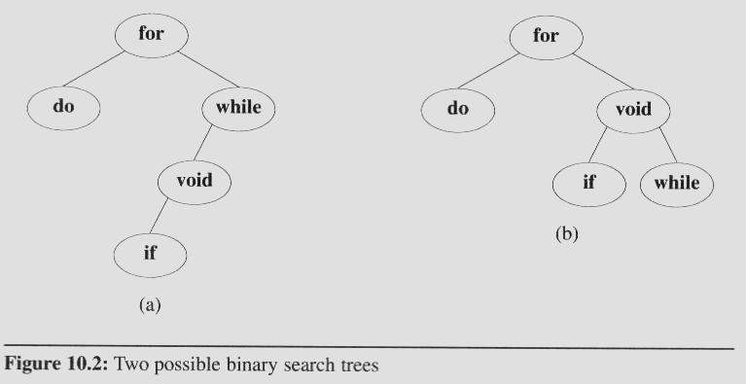
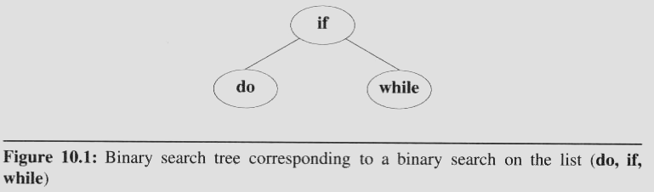
Optimal binary search trees
A full binary tree may not be an optimal binary search tree if the identifiers are searched for with different frequency
Consider these two search trees, If we search for each identifier with equal
Probability
In first tree (a)
the average number of comparisons for successful search is 2.4.
Comparisons for second tree is 2.2.
The second tree (b) has
a better worst case search time than the first tree.
a better average behavior.
(1+2+2+3+4)/5 = 2.4
(1+2+2+3+3)/5 = 2.2

Slide 19
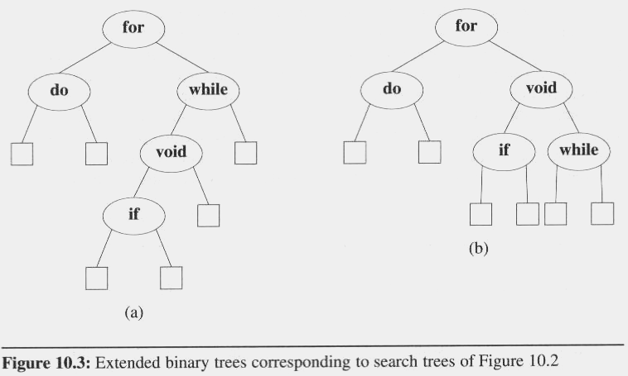
Optimal binary search trees
In evaluating binary search trees, it is useful to add a special square node at every place there is a null links.
We call these nodes external nodes.
We also refer to the external nodes as failure nodes.
The remaining nodes are internal nodes.
A binary tree with external nodes added is an extended binary tree

Slide 20
Optimal binary search trees
External / internal path length
The sum of all external / internal nodes’ levels.
For example
Internal path length, I, is:
I = 0 + 1 + 1 + 2 + 3 = 7
External path length, E, is :
E = 2 + 2 + 4 + 4 + 3 + 2 = 17
A binary tree with n internal nodes are related
by the formula : E = I + 2n
0
1
1
2
2
2
2
3
3
4
4

Slide 21
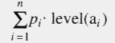
Optimal binary search trees
In the binary search tree:
The identifiers a₁, a₂, …, a_{n} with a₁ < a₂ < … < a_{n}
The probability of searching for each a_{i} is p_{i}
The total cost (when only successful searches are made) is:

Slide 22
Optimal binary search trees
If we replace the null subtree by a failure node, we may partition the identifiers that are not in the binary search tree into n+1 classes E_{i}, 0 ≤ i ≤ n
E_{i} contains all identifiers x such that a_{i} < x < a_{i+1}
For all identifiers in a particular class, E_{i}, the search terminates at the same failure node

Slide 23
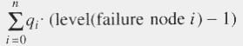
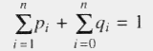
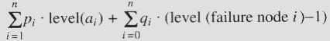
Optimal binary search trees
We number the failure nodes from 0 to n with i being for class E_{i}, 0 ≤ i ≤ n.
If q_{i} is the probability that the identifier we are searching for is in E_{i}, then the cost of the failure node is:
Therefore, the total cost of a binary search tree is:
An optimal binary search tree for the identifier set a₁, …, a_{n} is one that minimizes
Since all searches must terminate either successfully or unsuccessfully, we have

Slide 24
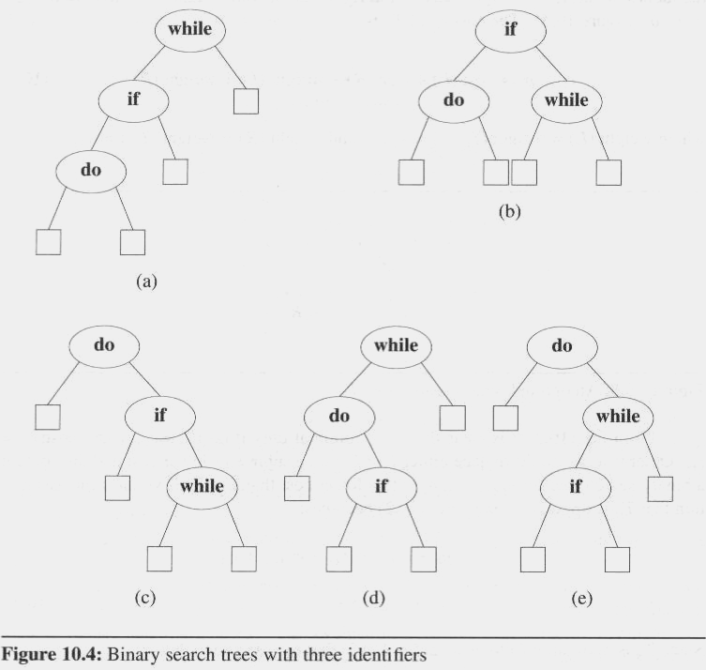
Optimal binary search trees
The possible binary search trees for the identifier set (a₁, a₂, a₃) = (do, if, while)
The identifiers with equal probabilities, p_{i}=q_{j}=1/7 for all i, j,
cost(tree a) = 15/7;
cost(tree b) = 13/7; (optimal)
cost(tree c) = 15/7;
cost(tree d) = 15/7;
cost(tree e) = 15/7;
p₁ = 0.5, p₂ = 0.1, p₃ = 0.05, q₀ = 0.15, q₁= 0.1, q₂ = 0.05, q₃ = 0.05
cost(tree a) = 2.65;
cost(tree b) = 1.9;
cost(tree c) = 1.5; (optimal)
cost(tree d) = 2.05;
cost(tree e) = 1.6;

Slide 25
OPTIMAL BINARY SEARCH TREES (Continued)
With equal probability P(i)=Q(i)=1/7.
Let us find an OBST out of these.
Cost(tree a)=∑P(i)*level a(i) +∑Q(i)*level (Ei) -1
1≤i≤n 0≤i≤n
(2-1) (3-1) (4-1) (4-1)
=1/7[1+2+3 + 1 + 2 + 3 + 3 ] = 15/7
Cost (tree b) =17[1+2+2+2+2+2+2] =13/7
Cost (tree c) =cost (tree d) =cost (tree e) =15/7
∴ tree b is optimal.

Slide 26
OPTIMAL BINARY SEARCH TREES (Continued)
If P(1) =0.5 ,P(2) =0.1, P(3) =0.005 , Q(0) =.15 , Q(1) =.1, Q(2) =.05 and Q(3) =.05 find the OBST.
Cost (tree a) = .5 × 3 +.1 × 2 + .05 × 3 +.15 × 3 + .1 × 3 + .05 × 2 + .05 × 1 = 2.65
Cost (tree b) =1.9 , Cost (tree c) =1.5 ,Cost (tree d) =2.05 ,
Cost (tree e) =1.6 Hence tree C is optimal.

Slide 27
Binary Search Tree - Worst Time
Worst case running time is O(N)
What happens when you Insert elements in ascending order?
Insert: 2, 4, 6, 8, 10, 12 into an empty BST
Problem: Lack of “balance”:
compare depths of left and right subtree
Unbalanced degenerate tree

Slide 28
Balanced and unbalanced BST
1
4
2
2
5
3
1
3
4
4
Is this “balanced”?
5
2
6
6
1
3
5
7
7

Slide 29
Balancing Binary Search Trees
Many algorithms exist for keeping binary search trees balanced
Adelson-Velskii and Landis (AVL) trees (height-balanced trees)
Splay trees and other self-adjusting trees
B-trees and other Multiway search trees

Slide 30
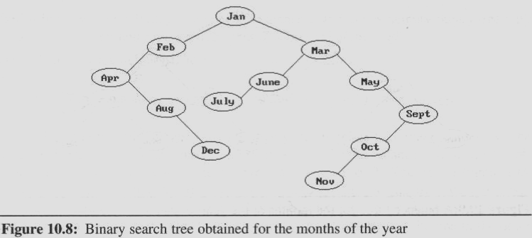
AVL Trees
We also may maintain dynamic tables as binary search trees.
The binary search tree obtained by entering the months January to December, in that order, into an initially empty binary search tree
The maximum number of comparisons needed to search for any identifier in the tree (for November).
Average number of comparisons is 42/12 = 3.5

Slide 31
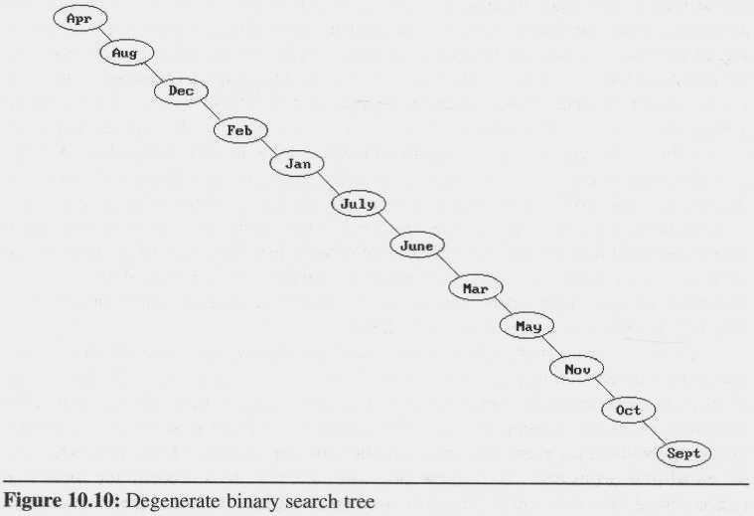
AVL Trees
Suppose that we now enter the months into an initially empty tree in alphabetical order
The tree degenerates into the chain number of comparisons: maximum: 12 and average: 6.5
In the worst case, binary search trees correspond to sequential searching in an ordered list

Slide 32
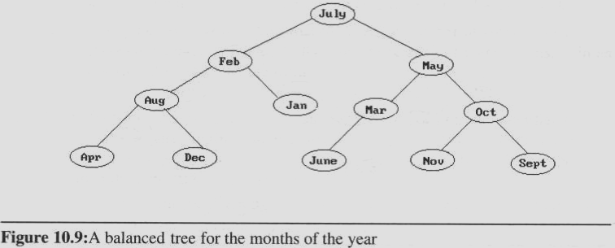
Another insert sequence
In the order Jul, Feb, May, Aug, Jan, Mar, Oct, Apr, Dec, Jun, Nov, and Sep
Well balanced and does not have any paths to leaf nodes that are much longer than others.
Number of comparisons: maximum: 4, and average: 37/12 ≈ 3.1.
All intermediate trees created during the construction of Figure are also well balanced

Slide 33
AVL Trees
Adelson-Velskii and Landis introduced a binary tree structure (AVL trees):
Balanced with respect to the heights of the subtrees.
We can perform dynamic retrievals in O(logn) time for a tree with n nodes.
We can enter an element into the tree, or delete an element from it, in O(logn) time. The resulting tree remain height balanced.
As with binary trees, we may define AVL tree recursively

Slide 34
Perfect Balance
Want a complete tree after every operation
tree is full except possibly in the lower right
This is expensive
For example, insert 2 in the tree on the left and then rebuild as a complete tree
6
5
Insert 2 &
complete tree
4
9
2
8
1
5
8
1
4
6
9

Slide 35
AVL - Good but not Perfect Balance
AVL trees are height-balanced binary search trees
Balance factor of a node
height(left subtree) - height(right subtree)
An AVL tree has balance factor calculated at every node
For every node, heights of left and right subtree can differ by no more than 1
Store current heights in each node

Slide 36
AVL Trees Definition
An empty binary tree is height balanced.
If T is a nonempty binary tree with T_{L} and T_{R} as its left and right subtrees, then T is height balanced iff
T_{L} and T_{R} are height balanced, and
|h_{L} - h_{R}| ≤ 1 where h_{L} and h_{R} are the heights of T_{L} and T_{R}, respectively.
The definition of a height balanced binary tree requires that every subtree also be height balanced

Slide 37
AVL Trees
The numbers by each node represent the difference in heights between the left and right subtrees of that node
We refer to this as the balance factor of the node
Definition:
The balance factor, BF(T), of a node, T, in a binary tree is defined as h_{L} - h_{R}, where h_{L/}h_{R} are the heights of the left/right subtrees of T.
For any node T in an AVL tree BF(T) = -1, 0, or 1.

Slide 38
AVL Trees
We carried out the rebalancing using four different kinds of rotations: LL, RR, LR, and RL
LL and RR are symmetric as are LR and RL
These rotations are characterized by the nearest ancestor, A, of the inserted node, Y, whose balance factor becomes ±2.
LL: Y is inserted in the left subtree of the left subtree of A.
LR: Y is inserted in the right subtree of the left subtree of A
RR: Y is inserted in the right subtree of the right subtree of A
RL: Y is inserted in the left subtree of the right subtree of A

Slide 39
Insertions in AVL Trees
Let the node that needs rebalancing be α.
There are 4 cases:
Outside Cases (require single rotation) :
1. Insertion into left subtree of left child of α.
2. Insertion into right subtree of right child of α.
Inside Cases (require double rotation) :
3. Insertion into right subtree of left child of α.
4. Insertion into left subtree of right child of α.
The rebalancing is performed through four separate rotation algorithms.

Slide 40
AVL Rotations
To perform rotations identify specific node A whose BF(A) is neither ( 0, 1, -1 ).
LL : Inserted node is in the left subtree of left subtree of node A. (SINGLE RIGHT ROTATION)
RR : Inserted node is in the right subtree of right subtree of node A. (SINGLE LEFT ROTATION)
LR : Inserted node is in the right subtree of left subtree of node A. (RR + LL)
RL : Inserted node is in the left subtree of right subtree of node A. (LL + RR)

Slide 41
AVL Balancing : Four Rotations
A
A
C
Double right
B
B
B
Single right
B
A
C
C
C
A
LL
LR
A
A
C
B
Single left
Double left
B
B
A
C
A
B
C
C
RL
RR

Slide 42
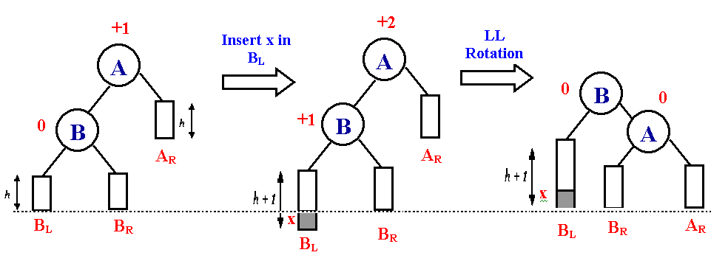
LL Rotations
Balanced AVL
tree
Unbalanced AVL
tree
Balanced AVL
Tree after
ROTATION
B_{L} : Left subtree of B
B_{R} : Right subtree of B
A_{R} : Right subtree of A
h : Height

Slide 43
LL Rotation
-1
-1
1
0
0
0
2
0
1
0
0
0
1
0
1
0
0
0
0
0
0
0
simple right rotation required

Slide 44
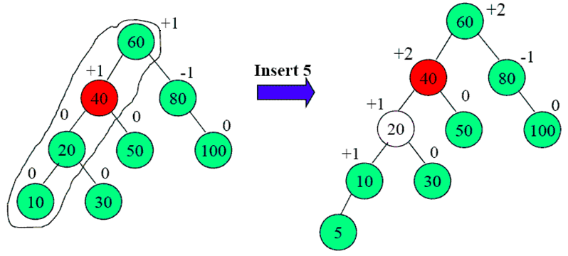
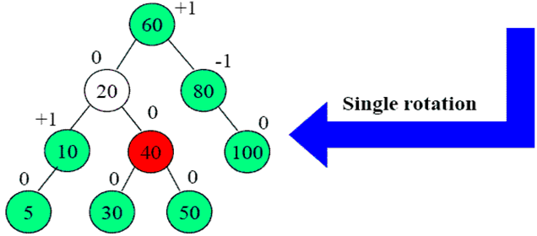
LL Rotation
LL

Slide 45
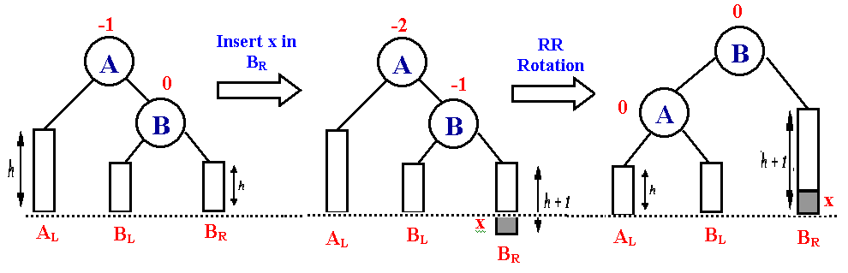
RR Rotations
Balanced AVL
tree
Unbalanced AVL
tree
Balanced AVL
Tree after
ROTATION

Slide 46
RR Rotation
200
100
-1
0
-2
100
235
0
0
200
0
90
-1
-1
175
90
175
239
0
0
1
0
235
0
1
0
-1
-1
85
95
85
215
0
0
0
239
0
0
0
0
-1
105
215
95
105
251
0
251
simple left rotation required

Slide 47
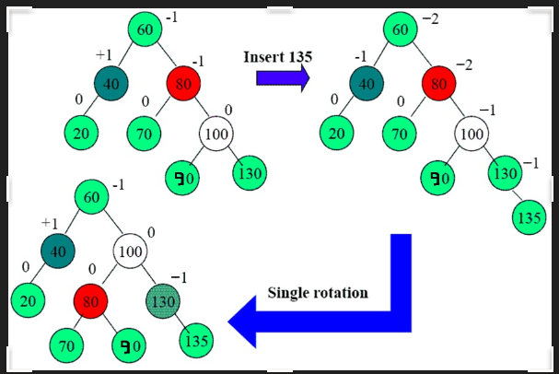
RR Rotation
RR

Slide 48
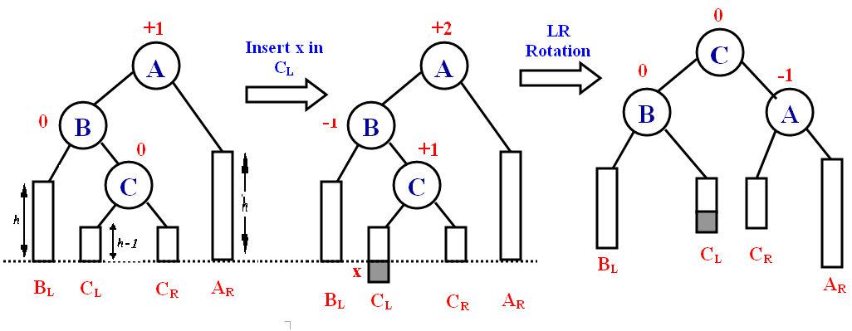
LR Rotations
Balanced AVL
tree
Unbalanced AVL
tree
Balanced AVL
Tree after
ROTATION

Slide 49
Double rotation, step 1
Examples
15
8
17
4
10
16
3
6
5
15
8
17
6
10
16
4
3
5

Slide 50
Double rotation, step 2
15
8
17
6
10
16
4
3
5
15
6
17
4
8
16
3
5
10

Slide 51
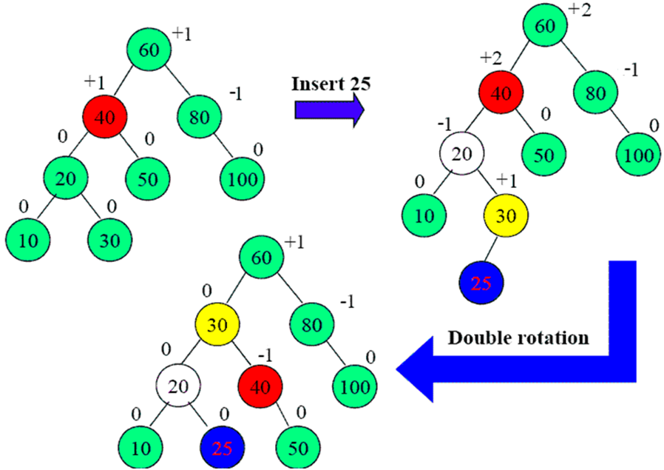
Example 1
LR

Slide 52
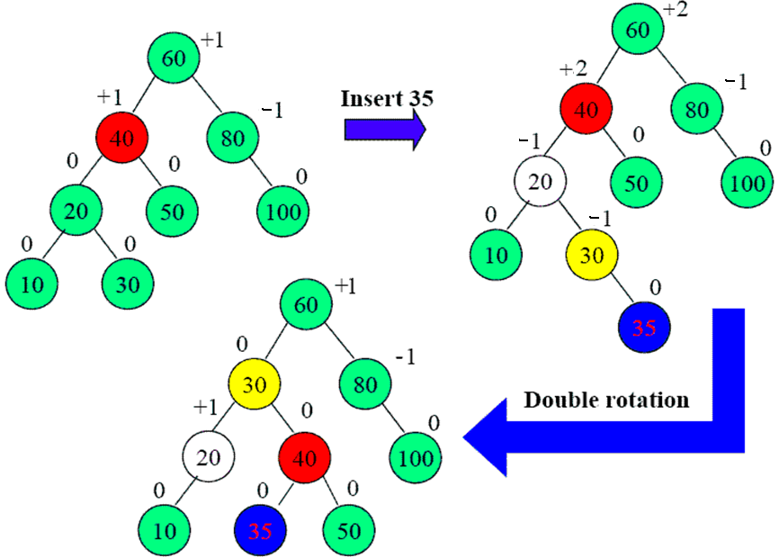
Example 2
LR

Slide 53
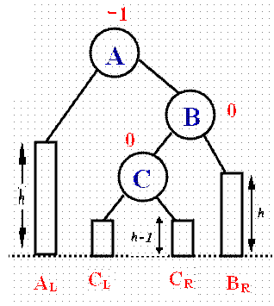
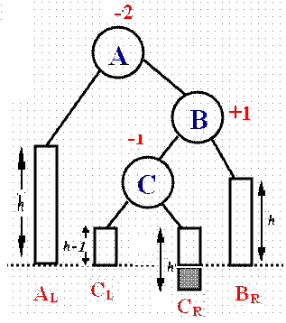
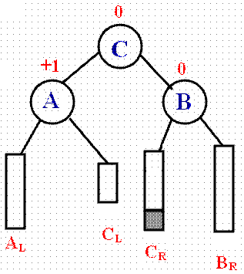
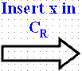
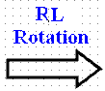
RL Rotations
Balanced AVL
tree
Unbalanced AVL
tree
Balanced AVL
Tree after
ROTATION

Slide 54
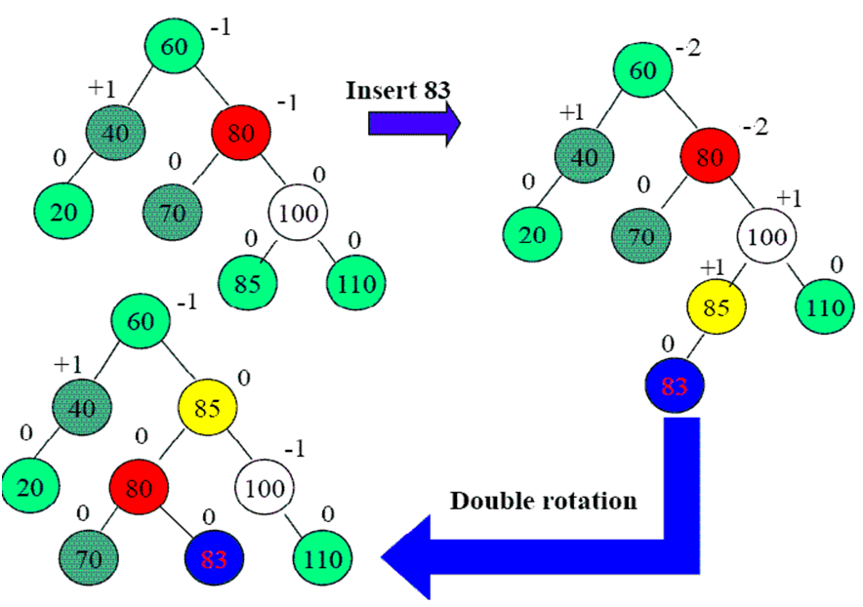
Example 1
RL

Slide 55
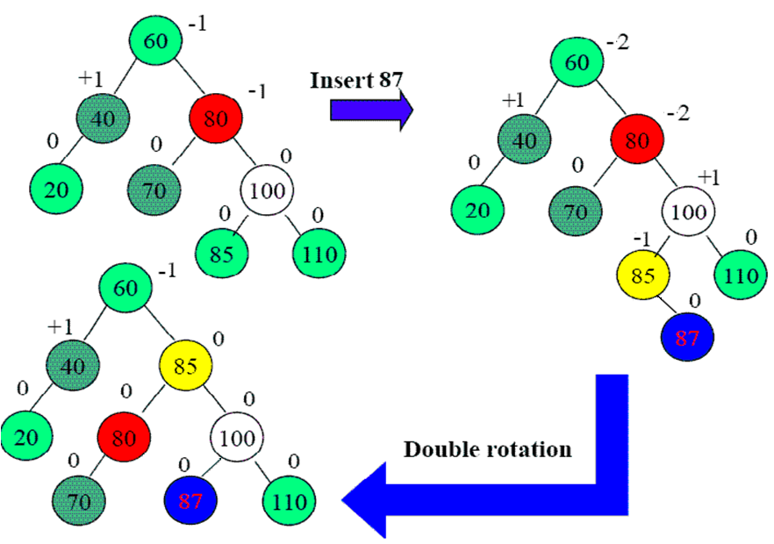
Example 2
RL

Slide 56
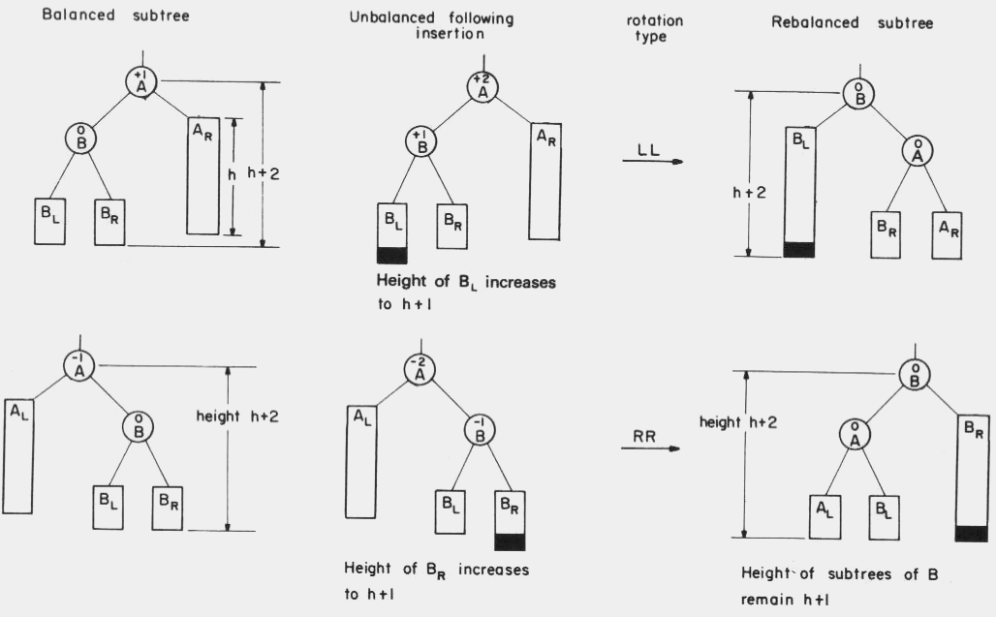
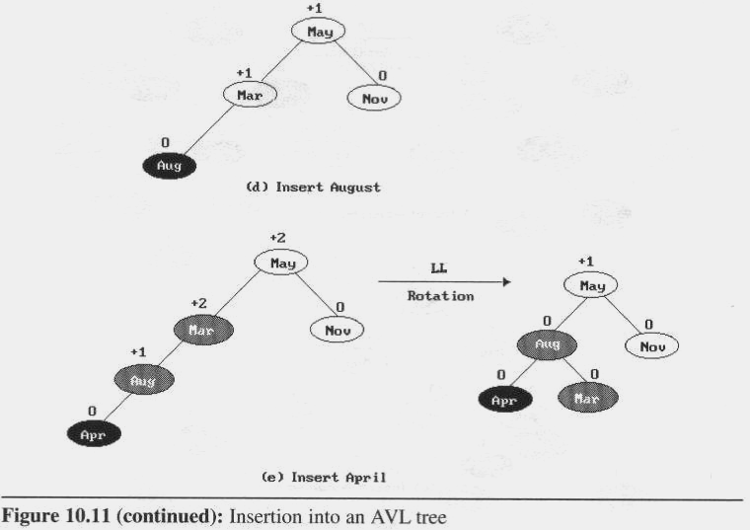
Rebalancing rotations

Slide 57
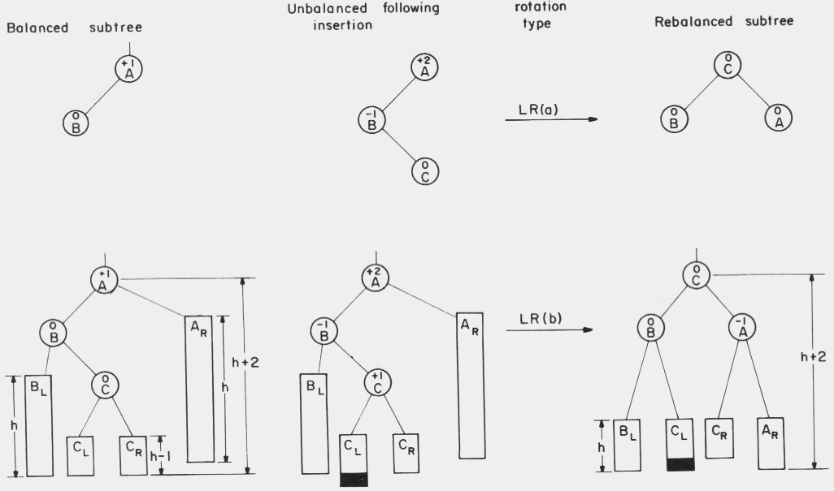
AVL Trees
Rebalancing rotations (cont’d)

Slide 58
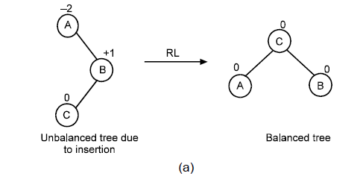
Case 4: RL (Left of Right)

Slide 59
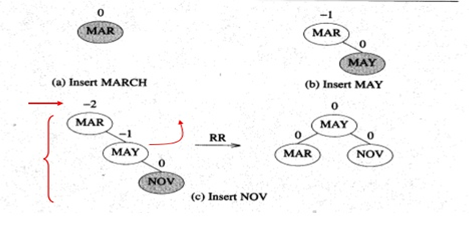
This time we will insert the months into the tree in the order
Mar, May, Nov, Aug, Apr, Jan, Dec, Jul, Feb, Jun, Oct, Sep
It shows the tree as it grows, and the restructuring involved in keeping it balanced.

Slide 60
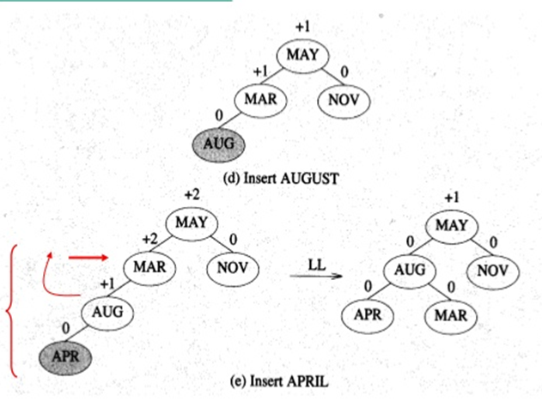
This time we will insert the months into the tree in the order
Mar, May, Nov, Aug, Apr, Jan, Dec, Jul, Feb, Jun, Oct, Sep
It shows the tree as it grows, and the restructuring involved in keeping it balanced.

Slide 61
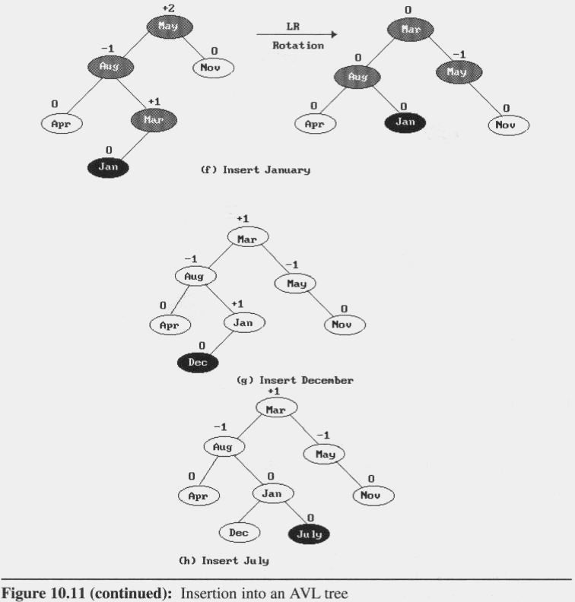
Rebalancing rotations (cont’d)

Slide 62
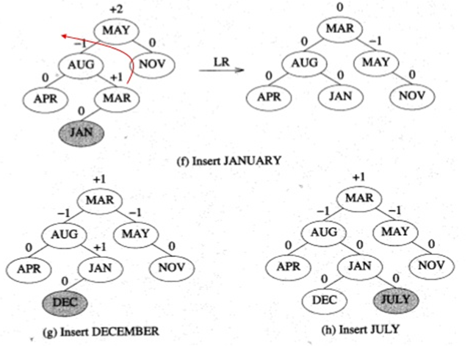

Slide 63
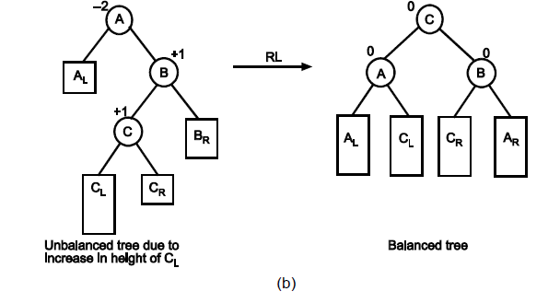
Case 4: RL(Left of Right)

Slide 64
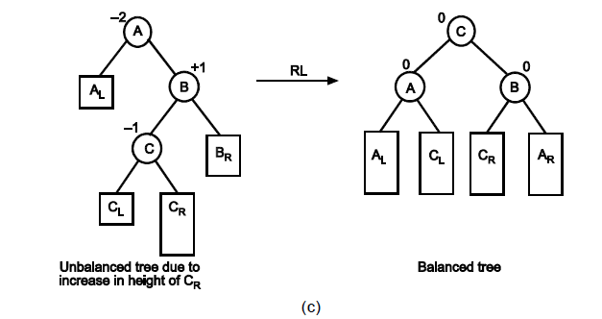
Case 4: RL (Left of Right)

Slide 65
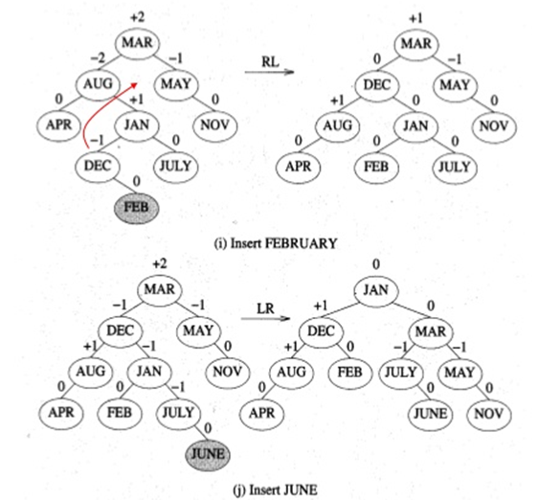

Slide 66
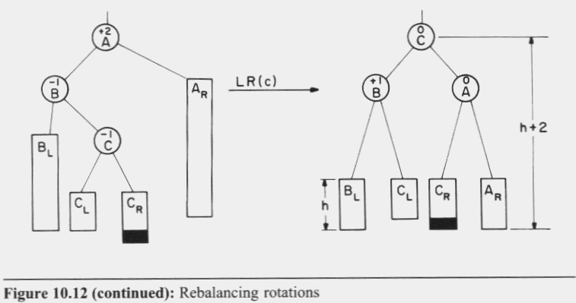
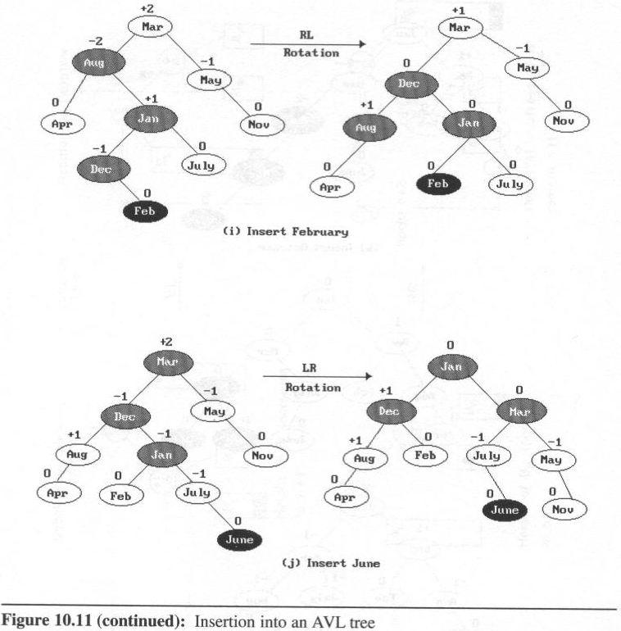
Case 3: LR (Left of Right )

Slide 67
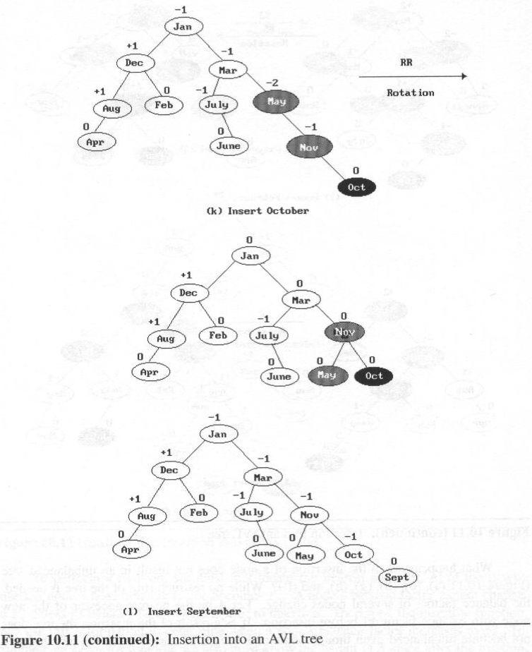
AVL Trees

Slide 68
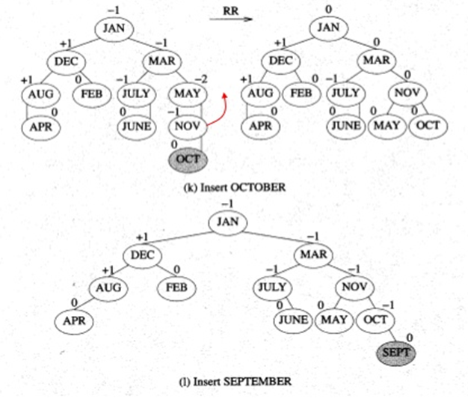

Slide 69
class avlTree
{ avl_node *root;
public:
int height(avl_node *);
int diff(avl_node *);
avl_node *rr_rotation(avl_node *);
avl_node *ll_rotation(avl_node *);
avl_node *lr_rotation(avl_node *);
avl_node *rl_rotation(avl_node *);
avl_node* balance(avl_node *);
avl_node* insert();
avl_node* insert(avl_node *, avl_node *);
void display(avl_node *, int);
void inorder(avl_node *);
void preorder(avl_node *);
void postorder(avl_node *);
avlTree()
{
root = NULL;
}
};
Node Structure for AVL Tree
class avl_node
{
int value;
avl_node *left, *right;
public:
friend class avlTree;
};

Slide 70
LL Rotation
parent
avl_node* avlTree:: LL_rotation (avl_node *parent)
{
avl_node * temp = parent->left;
parent->left = temp->right;
temp->right = parent;
return temp;
}
temp
return address

Slide 71
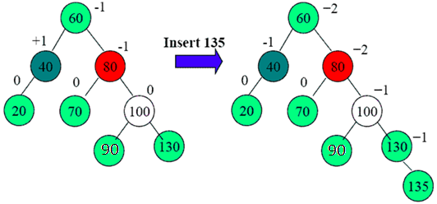
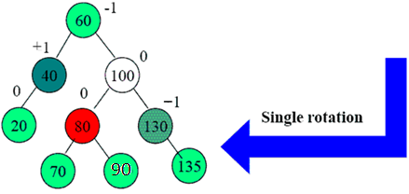
RR Rotation
avl_node* avlTree:: RR_rotation (avl_node *parent)
{
avl_node* temp = parent->right;
parent->right = temp->left;
temp->left = parent;
return temp;
}
parent
temp
return address

Slide 72
LR Rotation
parent
temp
return address
avl_node* avlTree:: LR_rotation (avl_node *parent)
{
avl_node *temp = parent->left;
parent->left = RR_rotation (temp); //calling RR rotation
return LL_rotation (parent);
// return root after LL rotation
}

Slide 73
parent
RL Rotation
temp
return address
avl_node* avlTree:: RL_rotation (avl_node *parent)
{
avl_node *temp = parent->right;
parent->right = LL_rotation (temp); // calling LL rotation
return RR_rotation (parent);
// return root after RR rotation
}

Slide 74
int avlTree::diff(avl_node *temp)
{
int l_height = height (temp->left);
int r_height = height (temp->right);
int b_factor= l_height - r_height;
return b_factor;
}
int avlTree::height(avl_node *temp)
{
int h = 0;
if (temp != NULL)
{
int l_height = height (temp->left);
int r_height = height (temp->right);
int max_height = max (l_height, r_height);
h = max_height + 1;
}
return h;
}
-1
2
0
0
1
7
0
5
8
0

Slide 75
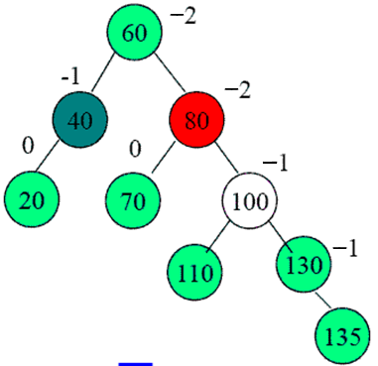
avl_node* avlTree:: balance(avl_node *temp)
{
int bal_factor = diff (temp);
if (bal_factor > 1)
{
if (diff (temp->left) > 0)
temp = LL_rotation (temp);
else
temp = LR_rotation (temp);
}
else if (bal_factor < -1)
{
if (diff (temp->right) > 0)
temp = RL_rotation (temp);
else
temp = RR_rotation (temp);
}
return temp;
}

Slide 76
void avlTree::insert()
{
char ch;
do
{
avl_node *temp;
cout<<“Enter word and it’s meaning”;
cin>>temp->word>>temp->meaning;
root=insert(root, temp);
cout<<“Enter your choice”;
cin>>ch;
}while(ch == ‘Y’);
}

Slide 77
avl_node* avlTree:: insert( avl_node *root, avl_node *temp)
{
if (root == NULL)
{
root = new avl_node;
root->word= temp->word;
root->meaning= temp->meaning;
root->left = NULL;
root->right = NULL;
return root;
}
else if (temp->word< root->data)
{
root->left = insert(root->left, temp);
root = balance (root);
}
else if (temp->word >= root->data)
{
root->right = insert(root->right, temp);
root = balance (root);
}
return root;
}
Insert 9
-2
2
0
-1
1
7
0
5
8
-1
9
0

Slide 78
Algorithm display (node *ptr, int level) // consider level =1
{
if (ptr!=NULL)
{ display(ptr->right, level + 1);
printf("\n");
if (ptr == root)
cout<<"Root -> ";
for (i = 0; i < level && ptr != root; i++)
cout<<" ";
cout<<ptr->data;
display(ptr->left, level + 1);
}
}

